Slide 1
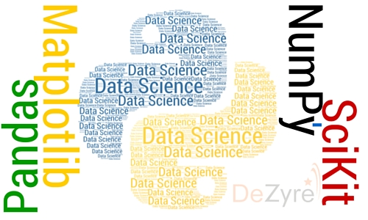
Classification, Clustering and Association Rules Mining MSBA Python Bootcamp – July 2022
Lecture 5
Facilitator: A/P TAN Wee Kek
Email: tanwk@comp.nus.edu.sg :: Tel: 6516 6731 :: Office: COM3-02-35

Slide 2

Learning Objectives
At the end of this lecture, you should understand:
Appreciate the limitation of regression models.
Convert a regression problem to classification problem.
Understand how decision tree classifier works.
How to perform decision tree classification.
Understand how k-means clustering works.
How to perform k-means clustering.
Understand what is association rules mining.
How to perform association rules mining.

Slide 3
Limitation of Linear Regression Models
Regression analysis is useful but suffers from an important limitation.
In linear regression models, the numerical dependent variable must be continuous:
The dependent variable can take on any value, or at least close to continuous.
In some data analytics scenarios, the dependent variable may not be continuous.
In other scenarios, it may be unnecessary to make a point prediction.
It is possible to convert a regression problem into a classification problem.

Slide 4
Parametric versus Non-parametric
Linear regression is parametric:
Assumes that sample data comes from a population that can be adequately modelled by a probability distribution that has a fixed set of parameters.
Assumptions can greatly simplify the learning process, but can also limit what can be learned.
Parametric ML algorithms:
Algorithms that simplify the function to a known form.
Non-parametric ML algorithms:
Algorithms that do not make strong assumptions about the form of the mapping function.
Free to learn any functional form from the training data.

Slide 5
Parametric versus Non-parametric (cont.)
Non-parametric ML methods are good when:
You have a lot of data and no prior knowledge.
You do not want to worry too much about choosing just the right features.
Classification algorithms include both parametric and non-parametric:
Parametric – Logistic Regression, Linear Discriminant Analysis, Perceptron, Naive Bayes, Simple Neural Networks
Non-parametric – k-Nearest Neighbors, Decision Trees, Support Vector Machines

Slide 6

Data Mining Goes to Hollywood
Data mining scenario – Predicting the box-office receipt (i.e., financial success) of a particular movie.
Problem:
Traditional approach:
Frames it as a forecasting (or regression) problem.
Attempts to predict the point estimate of a movie’s box-office receipt.
Sharda and Delen’s (2006) approach:
Convert the regression problem into a multinomial classification problem.
Classify a movie based on its box-office receipts into one of nine categories, ranging from “flop” to “blockbuster”.
Use variables representing different characteristics of a movie to train various classification models.

Slide 7
Classification with Decision Tree Classifier

Slide 8
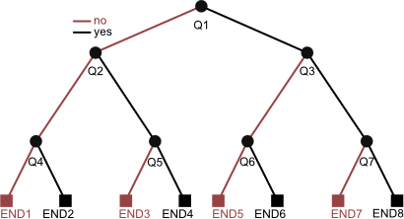
Decision Trees
The best known and most widely used learning methods in data mining applications.
Reasons for its popularity include:
Conceptual simplicity.
Ease of usage.
Computational speed.
Robustness with respect to missing data and outliers.
Interpretability of the generated rules.

Slide 9
Decision Trees (cont.)
The development of a decision tree involves recursive, heuristic, top-down induction:
Initialization phase – All observations are placed in the root of the tree. The root is placed in the active node list .
If the list is empty, stop the procedure. Otherwise, node is selected, removed from the list and used as the node for analysis.
The optimal rule to split the observations in is then determined, based on an appropriate preset criterion:
If does not need to be split, node becomes a leaf, target class is assigned according to majority class of observations.
Otherwise, split node , its children are added to the list.
Go to Step 2.

Slide 10
Components of Decision Trees
Components of the top-down induction of decision trees:
Splitting rules – Optimal way to split a node (i.e., assigning observations to child nodes) and for creating child nodes.
Stopping criteria – If the node should be split or not. If not, this node becomes a leaf of the tree.
Pruning criteria – Avoid excessive growth of the tree (pre-pruning) during tree generation phase, and reduce the number of nodes after the tree has been generated (post-pruning).
Exam ≥ 80?
Assignment ≥ 80%?
C
B
Assignment ≥ 50%?
B
A
A simple decision tree:
Left branch for “No”
Right branch for “Yes”

Slide 11
Example of a Decision Tree
Given the dataset:
The task is to predict Loan-Risk.
We will be using the univariate binary splitting approach.
Observation # | Income | Credit Rating | Loan Risk
0 | 23 | High | High
1 | 17 | Low | High
2 | 43 | Low | High
3 | 68 | High | Low
4 | 32 | Moderate | Low
5 | 20 | High | High

Slide 12
Example of a Decision Tree (cont.)
Given the data set , we start building the tree by creating a root node.
If this node is sufficiently “pure”, then we stop.
If we do stop building the tree at this step, we use the majority class to classify/predict.
In this example, we classify all patterns as having Loan-Risk = “High”.
Correctly classify 4 out of 6 input samples to achieve classification accuracy of:
This node is split according to impurity measures:
Gini Index (used by CART)
Entropy (used by ID3, C4.5, C5)
Loan-Risk = High
Acc = 66.67%

Slide 13
Using Gini Index
CART (Classification and Regression Trees) uses the Gini index to measure the impurity of a dataset:
Gini index for the observations in node is:
where
is the node that contains examples from classes
is a relative frequency of class in node
In our dataset, there are 2 classes High and Low, .

Slide 14

Using Gini Index (cont.)
Should Income be used as the variable to split the root node?
Income is a variable with continuous values.
Sort the data according to Income values:
Observation # | Income | Credit Rating | Loan Risk
1 | 17 | Low | High
5 | 20 | High | High
0 | 23 | High | High
4 | 32 | Moderate | Low
2 | 43 | Low | High
3 | 68 | High | Low
Split 1
Split 2
Split 3

Slide 15
Using Gini Index (cont.)
We consider 3 possible splits when there are changes in the value of Loan-Risk.
Case 1 – Split condition Income ≤ 23 versus Income > 23
Impurity after split:
Loan Risk = High
Acc = 66.67%
Gini(q) = 4/9
Income ≤ 23
Income > 23
$$I_{G}\left(q_{1}\right)$$
$$I_{G}\left(q_{2}\right)$$
3 High Loan-Risks
0 Low Loan Risk
Gini(q₁) = 0
1 High-Loan Risk
2 Low Loan Risk
Gini(q₂) = 4/9

Slide 16
Using Gini Index (cont.)
Case 2 – Split condition Income ≤ 32 versus Income > 32:
Case 3 – Split condition Income ≤ 43 versus Income > 43:
Case 1 is the best.
Instead of splitting between
Income ≤ 23 versus Income > 23,
the midpoint is selected as actual
splitting point: (23 + 32)/2.
Loan Risk = High
Acc = 66.67%
Gini (q) = 4/9
Income ≤ 27.5
Income > 27.5
3 High Loan-Risks
0 Low Loan Risk
Gini(q₁) = 0
1 High-Loan Risk
2 Low Loan Risk
Gini(q₂) = 4/9

Slide 17
Using Gini Index (cont.)
Apply the tree generating method recursively to nodes that are still not “pure”.
Develop a subtree by examining the variable Credit-Rating.
Credit-Rating is a discrete variable with ordinal values, i.e., they can be ordered in a meaningful sequence.
Loan Risk = High
Acc = 66.67%
Gini(q) = 4/9
Income ≤ 27.5
Income > 27.5
Loan Risk = High
Loan Risk = ?

Slide 18
Using Gini Index (cont.)
Possible values are .
Check for best split:
Case 1 – Low versus (Moderate or High)
Case 2 – (Low or Moderate) versus High
Compute the Gini index for splitting the node:
Loan Risk = ?

Slide 19
Using Gini Index (cont.)
Case 1 – Split Credit-Rating = Low versus Credit-Rating = Moderate or High:
Loan Risk = ?
Credit-Rating=Low
Credit-Rating=Moderate or High
0 Low Loan-Risk
1 High Loan Risk
Gini(q₁) = 0
2 Low Loan-Risk
0 High Loan Risk
Gini(q₂) = 0

Slide 20
Using Gini Index (cont.)
Case 2 – Split Credit-Rating = Low or Moderate versus Credit-Rating = High:
Case 2 split is not as good as Case 1 split.
Loan Risk = ?
Credit-Rating=Low or moderate
Credit-Rating=High
1 Low Loan-Risk
1 High Loan Risk
Gini(q₁) = 1/2
0 Low Loan-Risk
1 High Loan Risk
Gini(q₂) = 0

Slide 21
Using Gini Index (cont.)
Complete tree:
Root
Leaf
Intermediate
Income ≤ 27.5
Income > 27.5
Loan Risk = High
Loan Risk = ?
Credit-Rating=Low
Credit-Rating=Moderate or High
Loan Risk = High
Loan Risk = Low

Slide 22
Using Gini Index (cont.)
The tree achieves 100% accuracy on the training data set.
It may overfit the training data instances.
Trees may be simplified by pruning:
Removing nodes or branches to improve the accuracy on the test samples.
Tree growing could be terminated when the number of instances in the node is less than a pre-specified number.
Notice we have built a binary tree where every non-leaf nodes have 2 branches.

Slide 23
Decision Tree in Scikit Lean
We can perform decision tree classification using Scikit Learn’s tree.DecisionTreeClassifier.
However, this class cannot process categorical independent variables and thus we need to recode CreditRating:
Use one hot encoding or one-of-K scheme.
LoanRisk has three levels – Low, Moderate and High.
So we will create three binary variables – CreditRatingLow, CreditRatingModerate and CreditRatingHigh.
For each observation, only exactly one of these three variables will be set to 1.
Refer to sample source file src01 for the example.

Slide 24
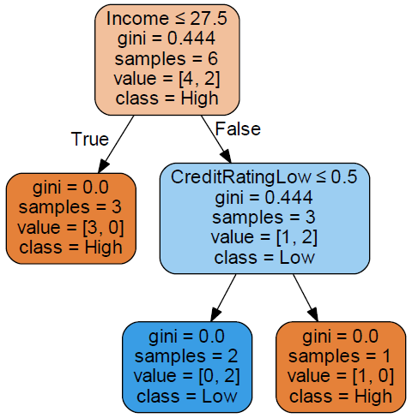
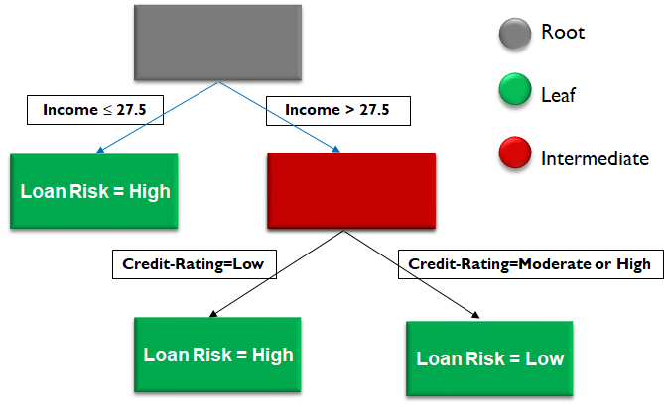
Decision Tree in Scikit Lean (cont.)

Slide 25
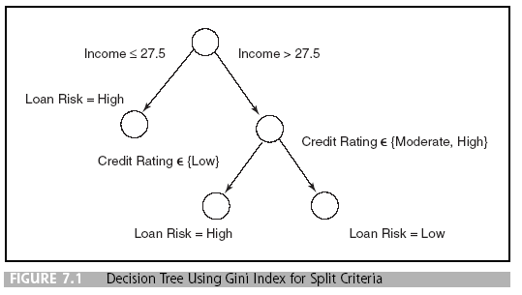
Classification Rule Generation
Trace each path from the root node to a leaf node to generate a rule:
If Income ≤ 27.5, then Loan-Risk = High
Else if Income > 27.5 and Credit-Rating=Low, then Loan-Risk = High
Else if Income > 27.5 and Credit-Rating= Moderate or High, then Loan-Risk = Low

Slide 26

Practical Exercise: PE07-01

Slide 27
Clustering with K-Means

Slide 28
Overview of Clustering
Clusters are homogeneous groups of observations.
To measure similarity between pairs of observations, a distance metric must be defined.
Clustering is an unsupervised learning process.
Focus of our discussions will be on:
Features of clustering models.
A partition method: K-means.
Quality indicators for clustering methods.

Slide 29
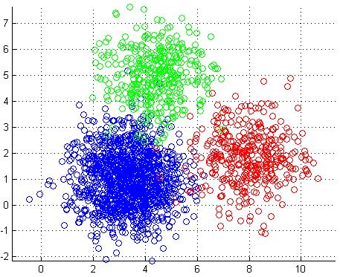
Clustering Methods
Aim – To subdivide the records of a dataset into homogeneous groups of observations called clusters.
Observations in a cluster are similar to one another and are dissimilar from observations in other clusters.
Purpose of clustering:
As a tool which could provide meaningful interpretation of the phenomenon of interest:
Example – Grouping consumers based on their purchase behavior may reveal the existence of a market niche.

Slide 30
Clustering Methods (cont.)
As a preliminary phase of a data mining project that will be followed by other methodologies within each cluster:
Example:
Clustering is done before classification.
In retention analysis, distinct classification models may be developed for various clusters to improve the accuracy in spotting customers with high probability of churning.
As a way to highlight outliers and identify an observation that might represent its own cluster.

Slide 31
Taxonomy of Clustering Methods
Based on the logic used for deriving the clusters.
Partition methods:
Develop a subdivision of the given dataset into a predetermined number K of non-empty subsets.
They are usually applied to small or medium sized data sets.
Hierarchical methods:
Carry out multiple subdivisions into subsets.
Based on a tree structure and characterized by different homogeneity thresholds within each cluster and inhomogeneity threshold between distinct clusters.
No predetermined number of clusters is required.

Slide 32
Affinity Measures
Clustering models are typically based on a measure of similarity between observations.
The measure can typically be obtained by defining an appropriate notion of distance between each pair of observations.
There are many popular metrics depending on the type of variables being analyzed.

Slide 33
Affinity Measures (cont.)
Given a dataset having observations
each described by n-dimensional variables, we compute
the distance matrix :
where is the distance between observations and .
for
is a symmetric matrix with zero diagonal.

Slide 34
Affinity Measures (cont.)
Similarity measure can be obtained by letting:
or
where is the max value of .

Slide 35
Affinity Measures for Numerical Variables
If all variables of the observations are numerical, the distance between and can be computed in four ways.
Euclidean distance (or 2 norm):
Manhattan distance (or 1 norm):

Slide 36
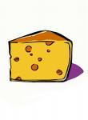
Affinity Measures for Numerical Variables (cont.)
Example: and
Euclidean distance (or 2 norm):
Manhattan distance (or 1 norm):
0 1 2 3 4 5
⬇
-4 -3 -2 -1
⬇

Slide 37
Partition Methods
Given a dataset , each represented by a vector in n-dimensional space, construct a collection of subsets
where .
is the number of clusters and is generally predetermined.
Clusters generated are usually exhaustive and mutually exclusive – Each observation belongs to only one cluster.
Partition methods are iterative:
Assign observations to the clusters.
Then iteratively reallocate to improve overall quality of clusters.

Slide 38
Partition Methods (cont.)
Criteria for quality:
Degree of homogeneity of observations in the same clusters.
Degree of heterogeneity with respect to observations in other clusters.
The methods terminate when during the same iteration no reallocation occurs, i.e., clusters are stable.

Slide 39
K-means Algorithm
Initialize: choose observations arbitrarily as the centroids of the clusters.
Assign each observation to a cluster with the nearest centroid.
If no observation is assigned to different cluster with respect to previous iteration, stop.
For each cluster, the new centroid is computed as the mean of the values belonging to that cluster. Go to Step 2.

Slide 40
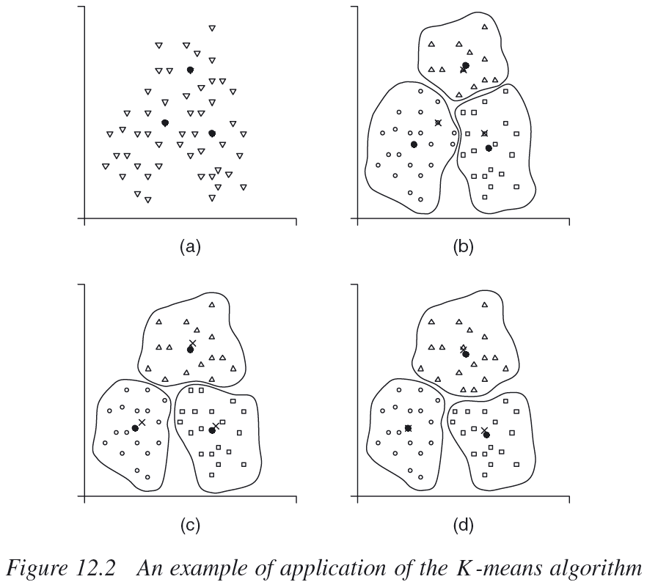
K-means Algorithm (cont.)
Source: Vercellis (2009), pp. 304

Slide 41
K-means Algorithm (cont.)
Given a cluster , , the centroid of the cluster is the point having coordinates equal to the mean value of each variable in the observations belonging to that cluster:
where is the number of observations in cluster .

Slide 42
K-means Algorithm (cont.)
Example – Suppose we have 2-dimensional data with the variables :
In Cluster 1, the observations are: .
In Cluster 2, the observations are: .
The centroids are:
Cluster 1:
Cluster 2:

Slide 43



Clustering Example – K-means
Iris classification problem:
3 classes – Setosa, Versicolor and Virginica.
4 variables – Sepal length, sepal width, petal length and petal width.
We use K-means clustering with K=3:
Silhouette Score = 0.5526 (positive and close to 1.0 is better)
Refer to sample source file src02 for the example.

Slide 44
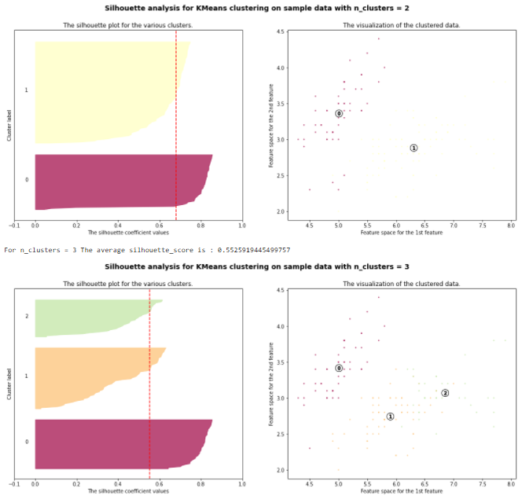
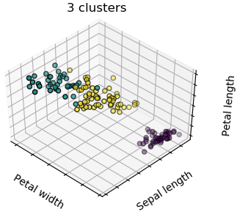
Clustering Example – K-means (cont.)
We can generate the silhouette diagrams for K=2 and K=3 for comparison:
See the sample script src03.

Slide 45
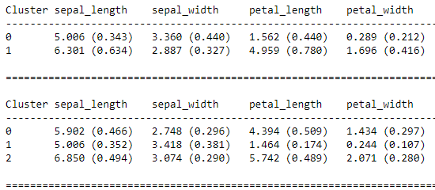
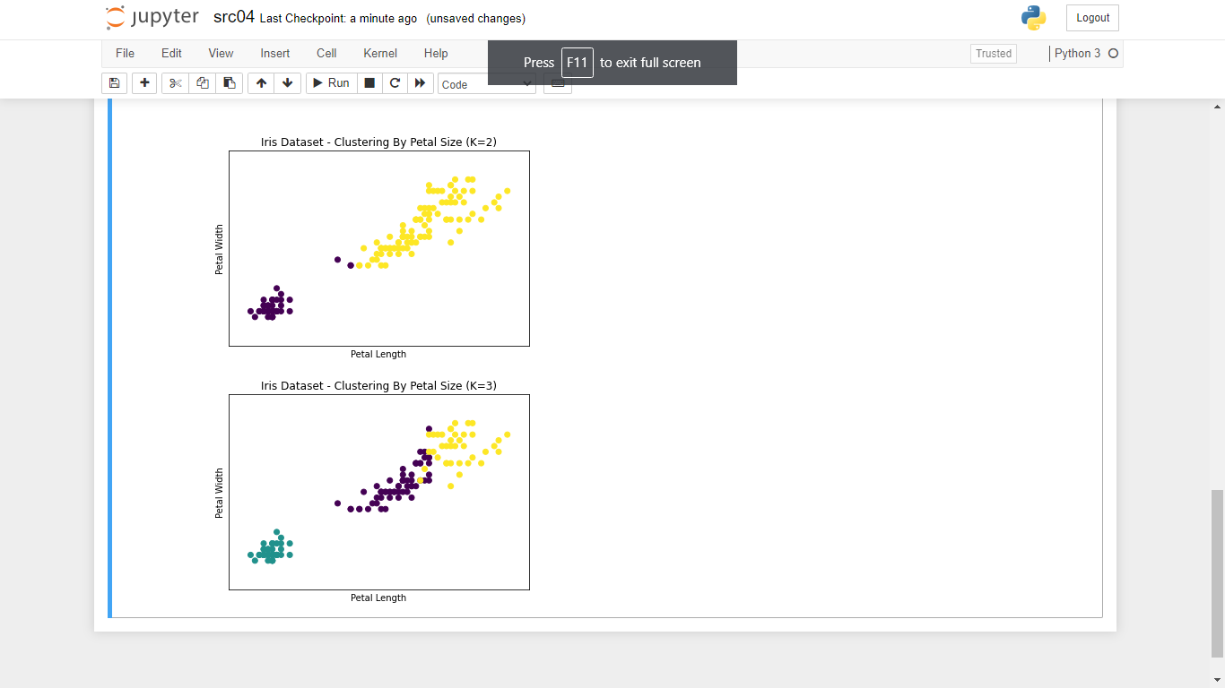
Clustering Example – K-means (cont.)
To identify the distinguishing characteristics of observations in each cluster:
We can compute the within-cluster means and standard deviations of the independent variables.
Plot scatter plots of the observations using the required independent variables.
See the sample script src04.

Slide 46
Practical Exercise: PE07-02

Slide 47
Association Rules Mining

Slide 48
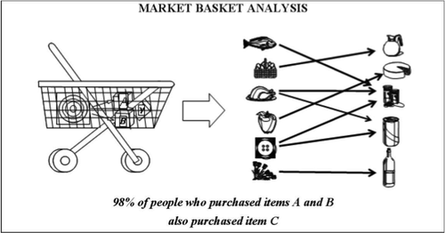
Overview of Association Rules
Association rules is a class of unsupervised learning models.
Aim of association rules is to identify regular patterns and recurrences within a large set of transactions.
Fairly simple and intuitive.
Frequently used to investigate:
Sales transactions in market basket analysis.
Navigation paths within websites.

Slide 49
Structure of Association Rules
Given two propositions and , which may be true or false, we can state in general terms that a rule is an implication of the type with the following meaning:
If is true then is also true.
A rule is called probabilistic if the validity of is associated with a probability .
That is, if is true then is also true with probability .
The notation read as “material implication”:
means if is true then is also true;
if is false then nothing is said about .

Slide 50
Representation of Association Rules
Let be a set of objects.
A generic subset is called an itemset.
An itemset that contains objects is called a k-itemset.
A transaction represents a generic itemset recorded in a database in conjunction with an activity or cycle of activities.
The dataset is composed of a list of transactions , each associated with a unique identifier denoted by .
Market basket analysis – The objects represent items from the retailer and each transaction corresponds to items listed in a sales receipt.

Slide 51
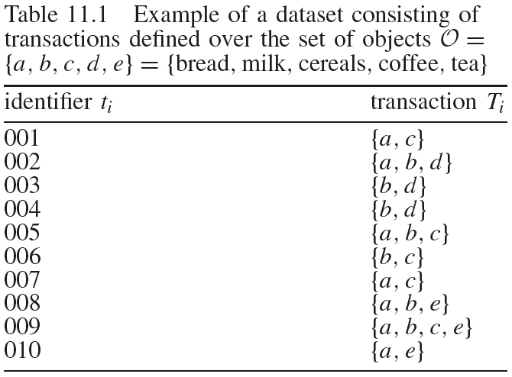
Representation of Association Rules (cont.)
Web mining – The objects represent the web pages in a website and each transaction corresponds to the list of web pages visited by a user during one session.
Example on market basket analysis:
This example is for market basket analysis.
In this example, and
.
Similarly, and the corresponding
.
Source: Vercellis (2009), pp. 279

Slide 52
Representation of Association Rules (cont.)
A dataset of transactions can be represented by a two-dimensional matrix :
The objects of the set correspond to the columns of the matrix.
The transactions are the rows.
The generic element of is defined as:

Slide 53
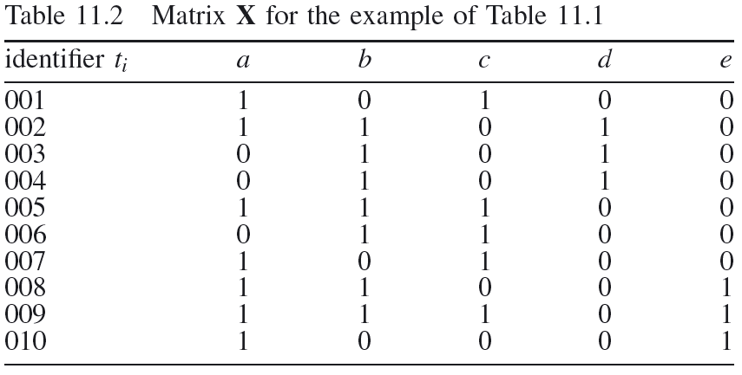
Representation of Association Rules (cont.)
Same example on market basket analysis:
Source: Vercellis (2009), pp. 280
Recall that
And

Slide 54
Representation of Association Rules (cont.)
The representation could be generalized:
Assuming that each object appearing in a transaction is associated with a number .
represents the frequency in which appears in .
Possible to fully describe multiple sales of a given item in a single transaction.
Let be a given set of objects, then transaction is said to contain the set if .
In the market basket analysis example, the 2-itemset is contained in the transaction with identifier .
But it is not contained in .

Slide 55
Representation of Association Rules (cont.)
The empirical frequency of an itemset is defined as the number of transactions existing in the dataset that contain the set :
For a large sample (i.e., as increases), the ratio
approximate the probability of occurrence of
itemset :
That is, the probability that is contained in a new transaction
recorded in the database.
In the market basket analysis example:
The set of objects has a frequency .
Probability of occurrence is estimated as .

Slide 56
Single-dimension Association Rules
Given two items and such that and a transaction , the association rule is a probabilistic implication denoted by with the following meaning:
If is contained in , then is also contained in with a given probability .
is termed the confidence of the rule in and defined as:
The set is called the antecedent or body of the rule.
is the consequent or head.

Slide 57
Single-dimension Association Rules (cont.)
The confidence of the rule indicates the proportion of transactions containing the set among those that include .
This refers to the inferential reliability of the rule.
As the number of transactions increases, the confidence approximates the conditional probability that
belongs to a transaction given that does belong
to :
Higher confidence thus corresponds to greater probability that itemset exists in a transaction that also contains the itemset .

Slide 58
Single-dimension Association Rules (cont.)
The rule is said to have a support in if the proportion of transactions containing both and is equal to :
The support of the rule expresses the proportion of transactions containing both the body and head of the rule.
Measures the frequency with which an antecedent-consequent pair appears together in the transactions of a dataset.
A low support suggests that a rule may have occurred occasionally, of little interest to decision maker and is typically discarded.

Slide 59
Single-dimension Association Rules (cont.)
As increases, the support approximates the probability that both and are contained in some future transactions.
In the market basket analysis example:
Given the itemsets and for the rule .
We have:

Slide 60
Strong Association Rules
Once a dataset of transactions has been assigned:
Determine minimum threshold value for the support.
Determine minimum threshold value for the confidence.
All strong association rules should be determined, characterized by:
A support ; and
A confidence .

Slide 61
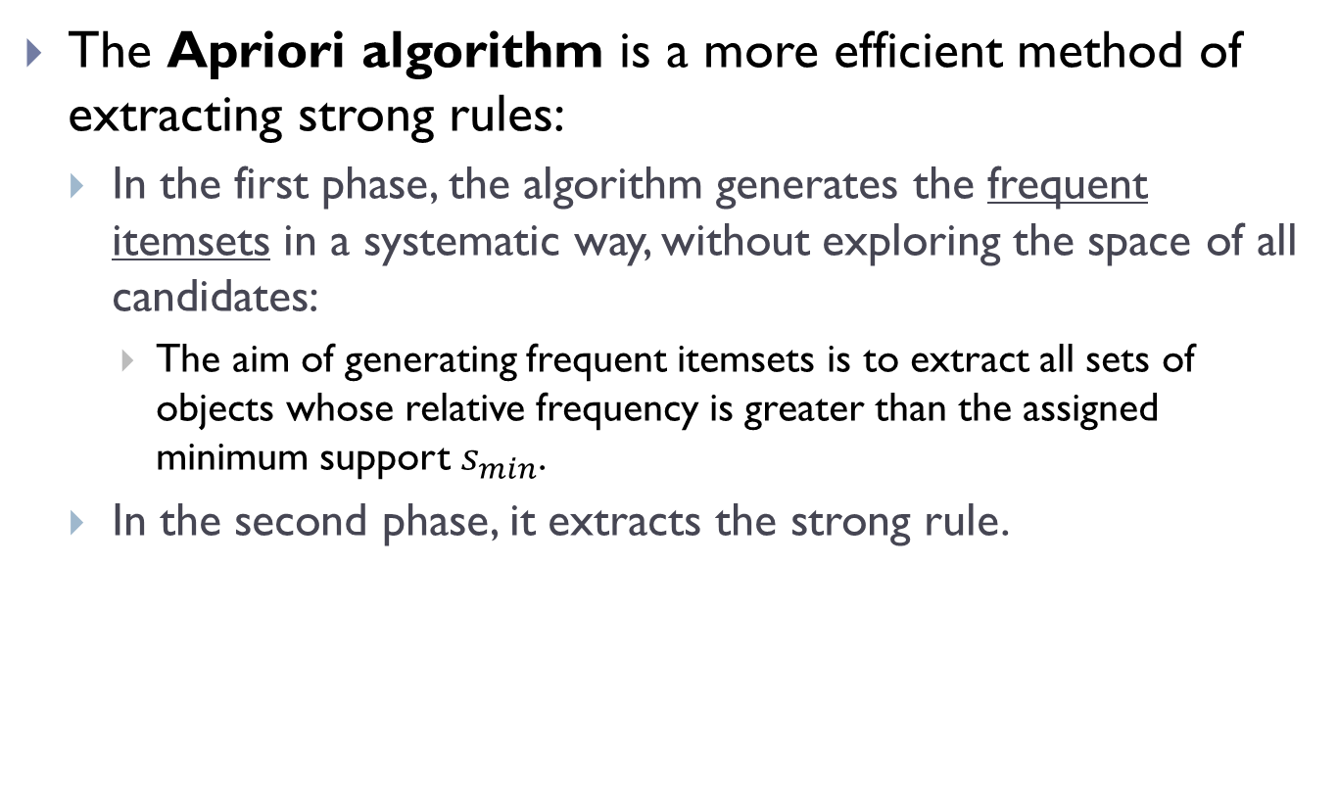
Apriori Algorithm
The Apriori algorithm is a more efficient method of extracting strong rules:
In the first phase, the algorithm generates the frequent itemsets in a systematic way, without exploring the space of all candidates:
The aim of generating frequent itemsets is to extract all sets of objects whose relative frequency is greater than the assigned minimum support $s_{min}$.
In the second phase, it extracts the strong rule.

Slide 62
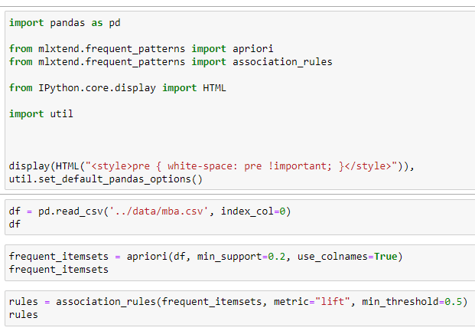

Example – Market Basket Analysis
Scikit Learn does not support the Apriori algorithm.
So we will use Mlxtend (machine learning extensions):
src05

Slide 63
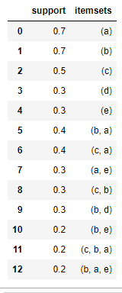
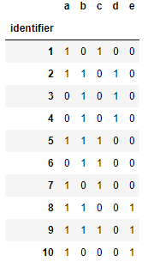
Example – Market Basket Analysis (cont.)
Original transactions dataset
Frequent itemsets

Slide 64
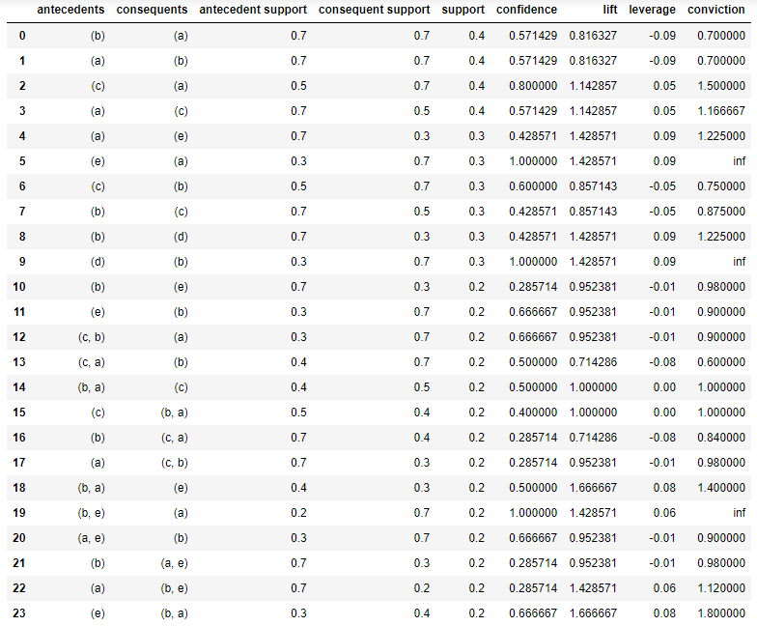
Example – Market Basket Analysis (cont.)

Slide 65
Practical Exercise: PE08-01 to PE08-02

